Slide 1

Smart Traffic Management System
Dynamic Traffic Signal Control
Team Name : FlowForce
Department: Computer Science and Engineering | Year: 3rd Year
Guide: Prof. Yogita Narule

Slide 2
Problem Statement
The Problem
Existing Solutions & Gaps
Existing approach | Limitation
Fixed-time signals | Do not adapt their timing to changing traffic demand.
Manual traffic control | Requires continuous human monitoring and intervention.
Emergency vehicle priority systems | May require dedicated communication and compatible infrastructur
CCTV-based traffic monitoring | Monitoring alone does not automatically optimize signal timings
Traffic signals often operate on predetermined timings that may not reflect the actual number of vehicles waiting in each lane.
Long waiting times - Vehicles wait even when traffic demand differs between lanes.
Uneven congestion - One approach may have a long queue while another has fewer vehicles.
Emergency delays - Congestion can delay emergency vehicles travelling through intersections.

Slide 3
Project Idea & Objectives
Our Idea
Objectives
A SUMO-based traffic system that dynamically adjusts signal timings and prioritizes emergency vehicles using Python and TraCI.
What is unique/innovative?
Traffic-responsive signals - Green-light duration changes based on simulated traffic conditions rather than relying only on fixed timings.
Emergency-vehicle priority - Includes a rule-based priority mechanism for emergency vehicles in the simulation
Testable simulation environment - SUMO and TraCI allow traffic scenarios and signal-control decisions to be tested in a simulated road network.
Adapt signal timings to simulated vehicle counts, lane density, speed, and waiting time.
Reduce unnecessary vehicle waiting through demand-based signal decisions.
Implement emergency-vehicle priority using predefined rules.
Evaluate traffic-control behaviour through simulation scenarios.

Slide 4
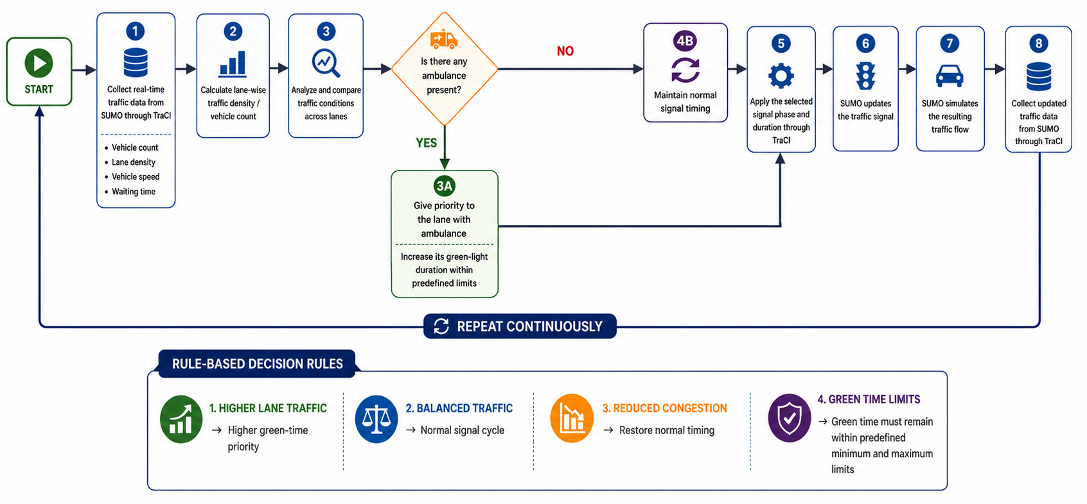
Prototype & Working
1
2
3
Input
Process
Output
What data or action starts the system?
How does your prototype work?
What result does the user get?

Slide 5
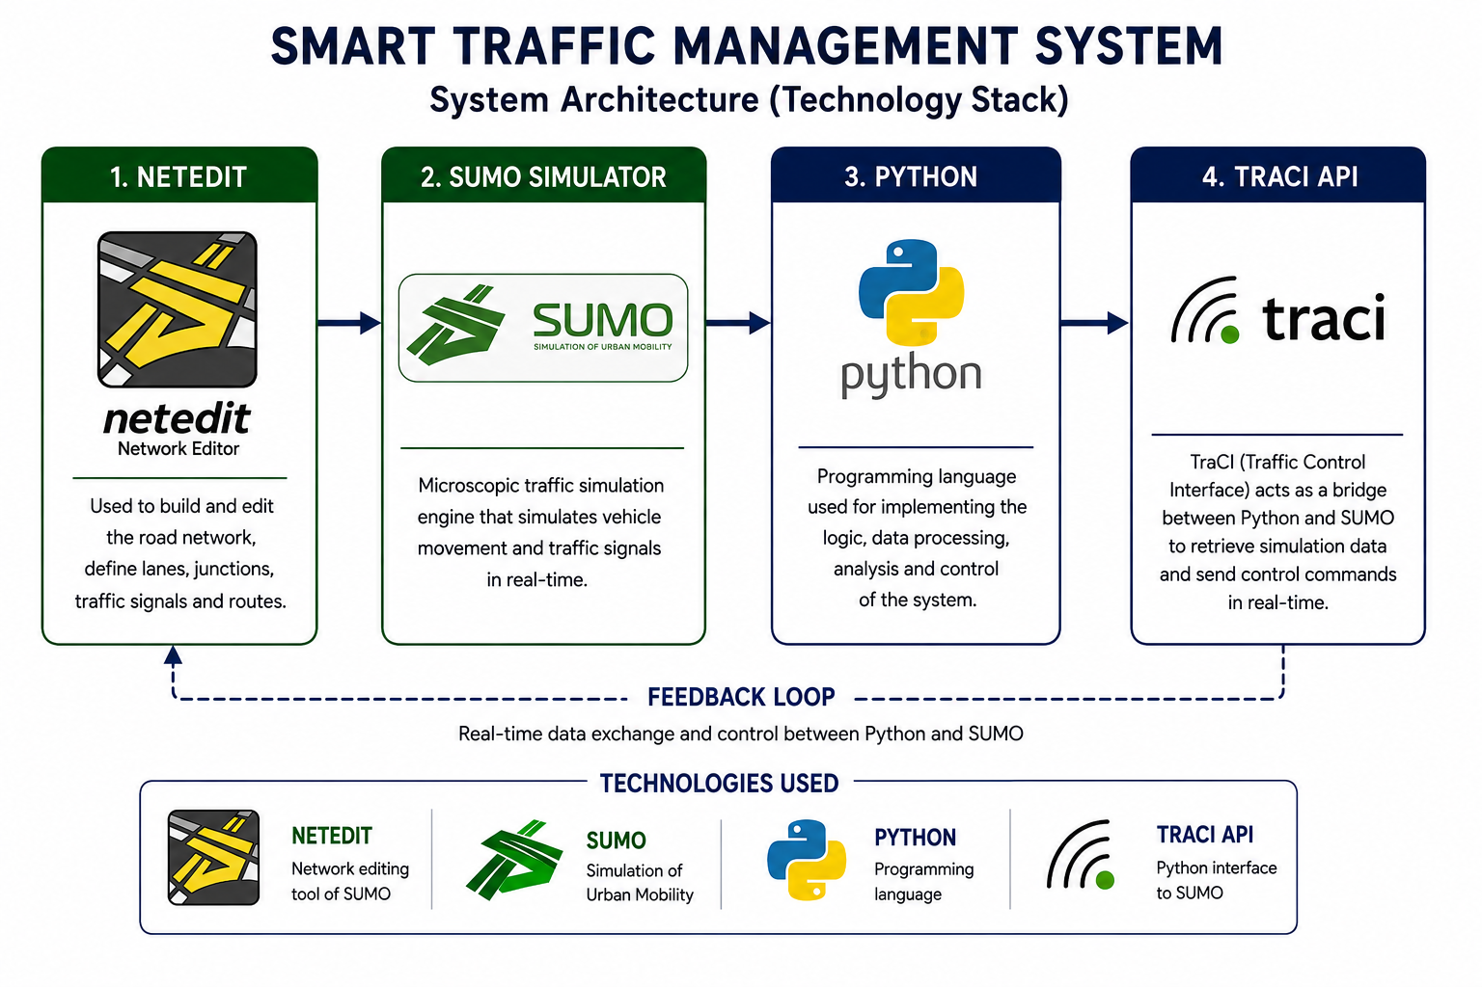
Technology Stack & Impact
Tools & Technologies
Impact & Future Scope
Potential Impact
Better allocation of green time
Reduced unnecessary waiting
Emergency-vehicle priority
Future Scope
Test on more complex road networks
Compare against fixed-time signals
Multi-intersection coordination
Explore real-world integration and deployment
Simulation:
Programming:
Control logic: Rule-based decision engine

Slide 6
Results & Conclusion
Fixed-time Control
Dynamic-time Control
Optimization
126 sec
79 sec
37.3%
Average waiting time
Average waiting time
Reduction in waiting time
Conclusion
The Smart Traffic Management System uses SUMO, TraCI, and Python to dynamically adjust traffic signal timings based on vehicle count, vehicle type, emergency vehicle and waiting time. The rule-based approach enables traffic-responsive signal control and prioritizes emergency vehicles within the simulated road network.

Slide 7
Thank You
Questions & Demo

